Slide 1
Review

Slide 2
期末考试
时间：2022年12月14日周三1-2节，8:00-9:50
地点：上课教室（仙II-103）
（请关注课程QQ群的通知）
闭卷
总成绩
不参加考试的同学无成绩，请及时联系教务员退选
参加考试的同学：
if (考试成绩>=作业成绩) then 考试成绩
else 作业40% + 考试60%
答疑：13日周二15:30-17:00，计算机系楼404
或课程QQ群

Slide 3
阅读理解&写作
If I show you a formal system, can you apply it to examples?
Given a small-step operational semantics, write down the execution paths of a configuration
Given a big-step operational semantics, write down the computation of the final results of a configuration
Given a program logic, write down the proof of a specification
Given a definition of a property, tell whether it holds
If I tell you the informal meaning of a property, can you formalize it? (Please do not use natural language in your formalization.)

Slide 4
Formal Semantics of Programming Languages
Lambda Calculus
Untyped
Simply typed
Imperative languages
Operational semantics
Hoare logic
Separation logic

Slide 5

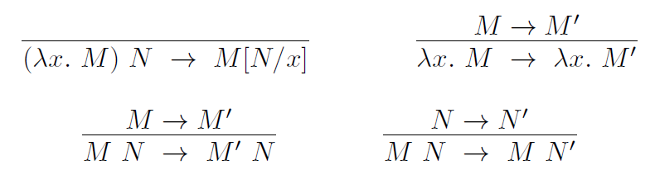
Untyped lambda calculus
Syntax
Semantics (reduction rules)

Slide 6
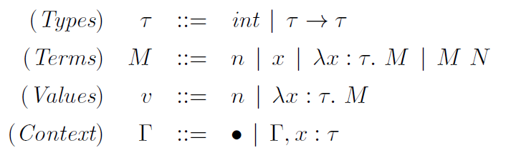
Simply-typed lambda calculus
Syntax
Reduction rules

Slide 7
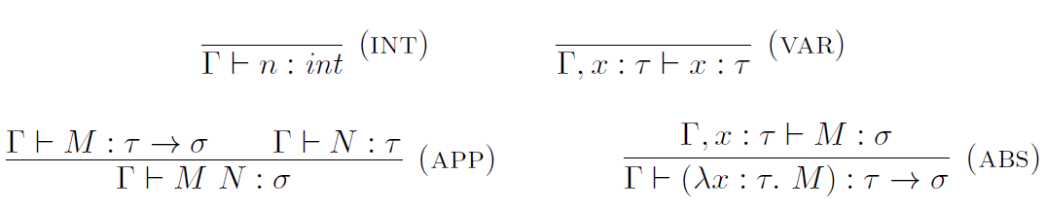
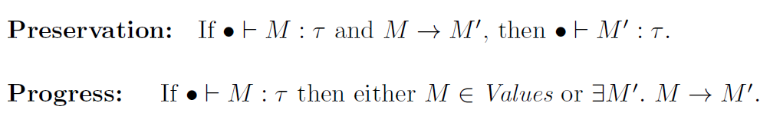
Simply-typed lambda calculus
Typing rules

Slide 8
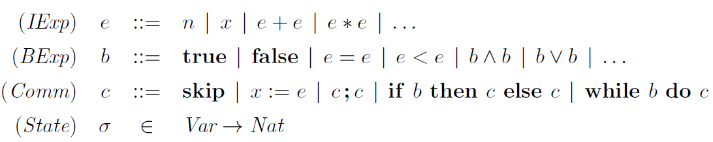
A simple imperative language
Syntax

Slide 9
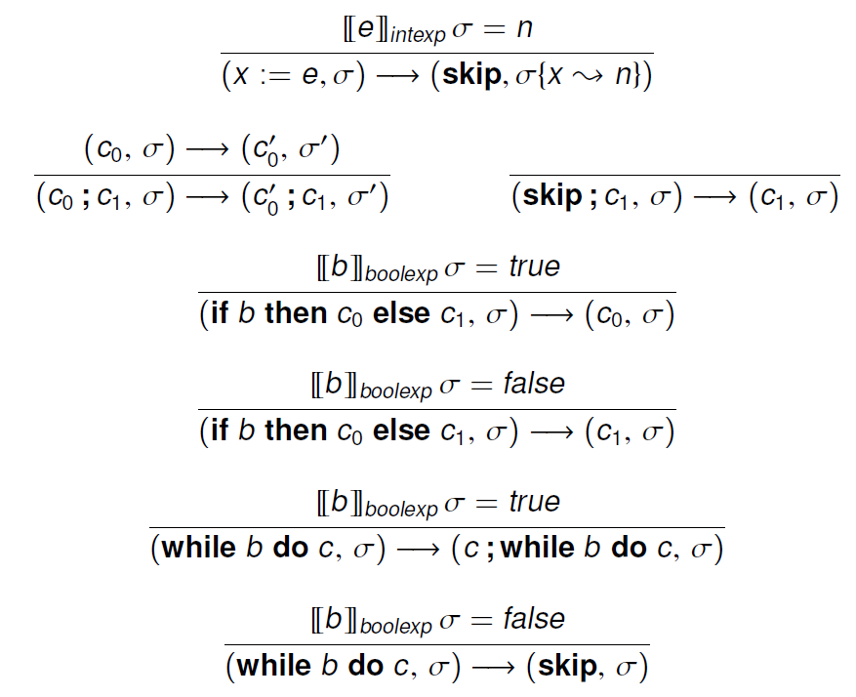
Operational semantics
Small-step

Slide 10
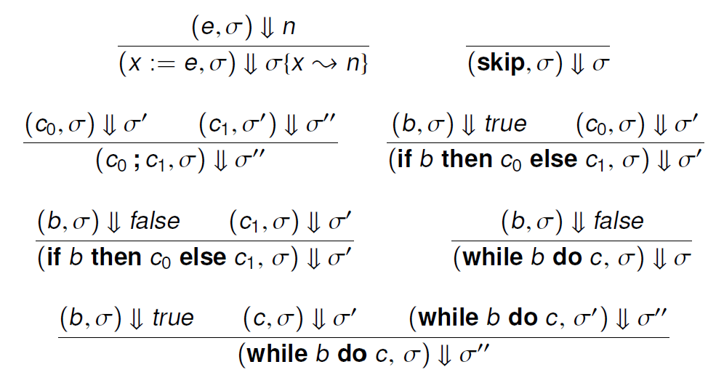
Operational semantics
Big-step

Slide 11
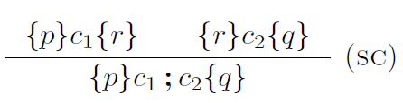


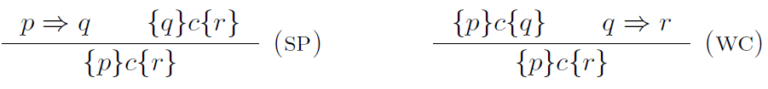
Hoare logic
Inference rules for partial correctness
Judgement semantics
Soundness theorem

Slide 12
Formal Semantics of Prog. Lang.
Lambda Calculus
Untyped
Reduction
Simply typed
Reduction vs typing : progress & preservation
Imperative languages
Operational semantics
Small-step & big-step
Hoare logic
Users: reasoning using logic rules; Designers: logic soundness
Separation logic
Assertion semantics & locality

